Slide 1
Fundamentals of Web Design
Pleasant Peaks
(Personal Blog)
Faisal Alkhammash
202311248

Slide 2
About the project
Pleasant Peaks is a small personal blog that can be used as a self introduction to who I am.
It contains information about me, my hobbies, my achievements, and more.

Slide 3




Color Scheme
Color | Hexadecimal Value | Used For
 | #6f6f6f & a5a5a5 Gradient | Background
 | #3bcce0 | Text & Footer
 | #ffffff & #000000 | Navigation Bar

Slide 4
Fonts Used
'Courier New', Courier, monospace
Only CSS fonts used.
The title is an image, using the font Castric Literature

Slide 5
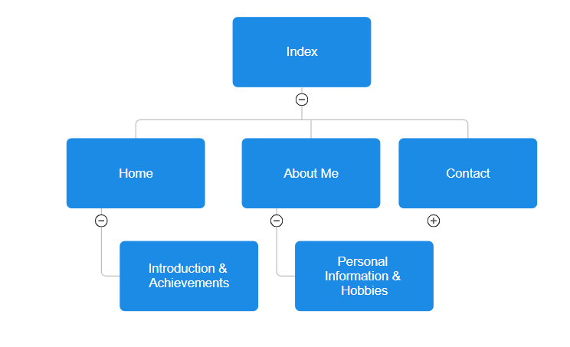
Page Hierarchy

Slide 6
Pages
Home
About Me
Contact Me

Slide 7
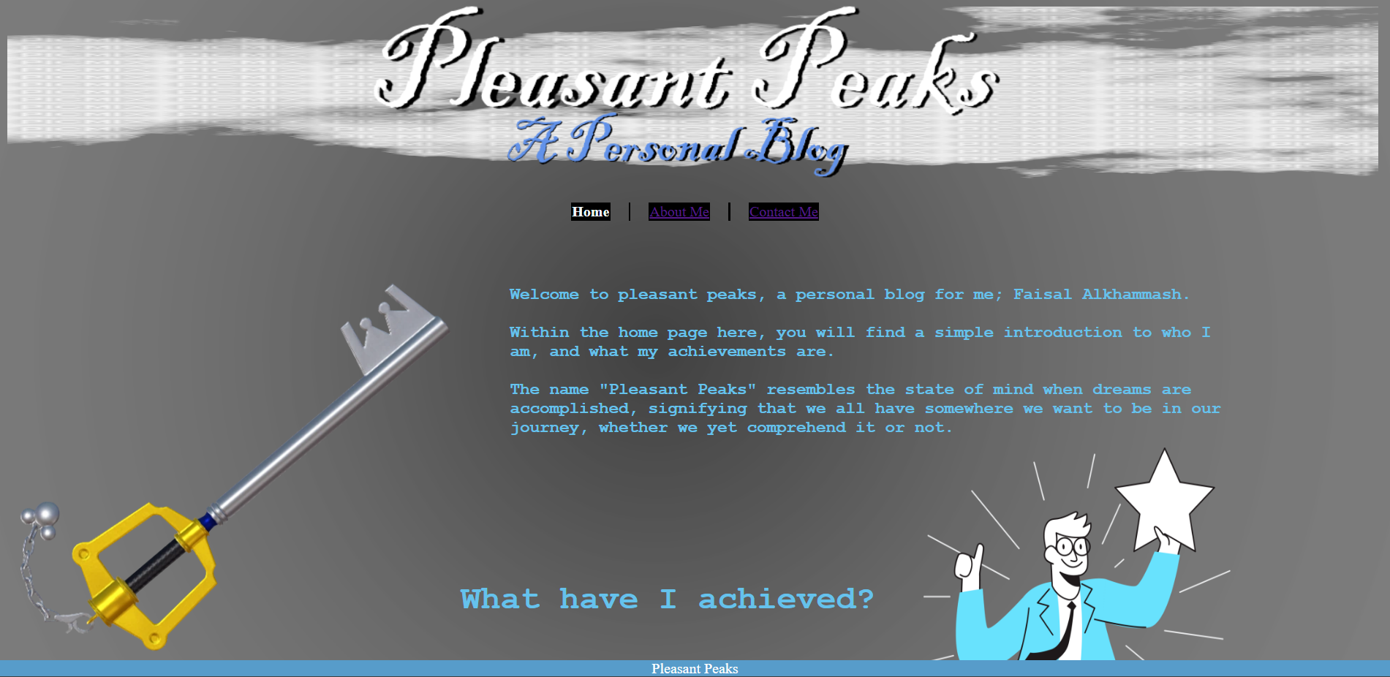
Home Page
The home page has information about the website and its meaning. It also includes a brief description of my achievements.

Slide 8
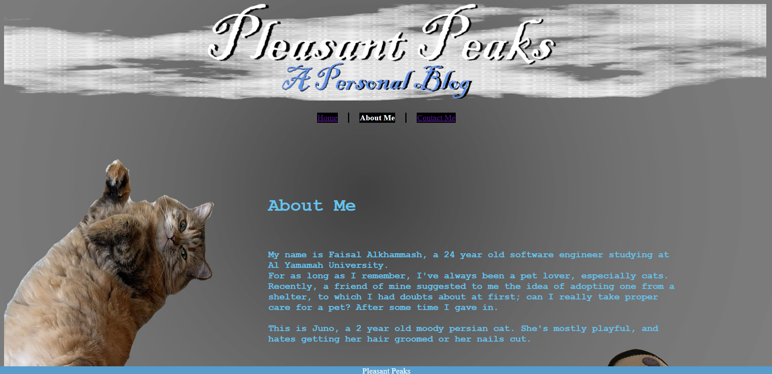
About Me Page
The About Me page includes an in-depth introduction of myself and my pet cat, Juno.
Clicking on the picture of Juno lets you hear her meow.

Slide 9
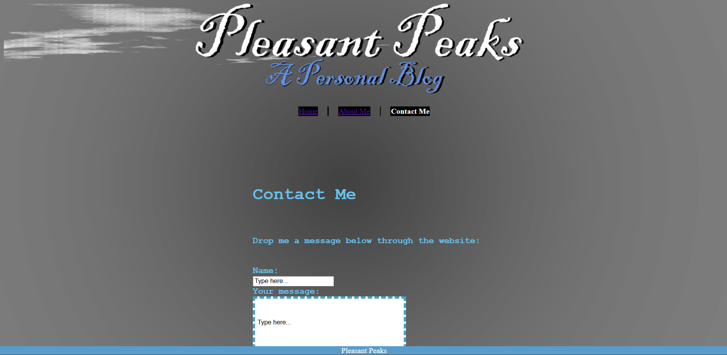
Contact Me Page
The contact me page is a small page where you can send messages directly to me, the creator of the blog.

Slide 10
External links
CSS
<link rel="stylesheet" href="../src/myCSS.css">
CSS Stylesheet used globally across all pages.
Javascript
<script src="../src/JVS.js"></script>
JS Script used for functions on “About Me” & “Contact Me” Pages

Slide 11
Thank you!

